Slide 1

END SEMESTER PROJECT PRESENTATION
RTI APPLICATION RECORD KEEPING SYSTEM
Presented by
Name: Mridul Barman
Enrollment No.: MCA1965028
MCA VI Semester
Under the Supervision of
Name of the Guide: Mr. Prakash Chauhan
Designation: Assistant Professor
Dept. of Computer Science & IT
Cotton University, Guwahati-01
Date: 18/08/2022

Slide 2
Content of the project report
About the project
Objective / aim of the project
System design
Snapshots
Result & discussion
Conclusion & future scope

Slide 3
About the project
Using the rti application record keeping system anyone can apply or manage already applied rti remotely. After applying the rti admins will send the replies to the users. The main objective of this project is to make applying for rti easy and accessible. Admins can filter old rti files very easily with applicants name and date.

Slide 4
Aim & Objective of the project
The main objective of this project is as follow:
Add and maintain records of the rti application digitally.
Make an easy to use environment for the user and admin.
Provide fast results of the application during searching.
File RTI remotely.
Access filed RTI from anywhere.

Slide 5
System design
System design is the process of defining the architecture components modules, interfaces and data for a system to satisfy specified requirements. It is a solution to the question of how to approach to the creation of a new important phase composed of several steps. It facilitates the understanding and procedural details for implementation of the system recommended in the feasibility study. A systemic approach is required for a coherent and well- running system. Bottom-Up or Top-Down approach is required to take into account all related variables of the system. A designer uses the modeling languages to express the information and knowledge in a structure of system that is defined by a consistent set of rules and definitions.

Slide 6
ER Diagram
An Entity Relationship (ER) Diagram is a type of flowchart that illustrates how “entities” such as people, objects or concepts relate to each other within a system. ER Diagrams are most often used to design or debug relational databases in the fields of software engineering, business information systems, education and research. Also known as ERDs or ER Models, they use a defined set of symbols such as rectangles, diamonds, ovals and connecting lines to depict the interconnectedness of entities, relationships and their attributes. They mirror grammatical structure, with entities as nouns and relationships as verbs.

Slide 7
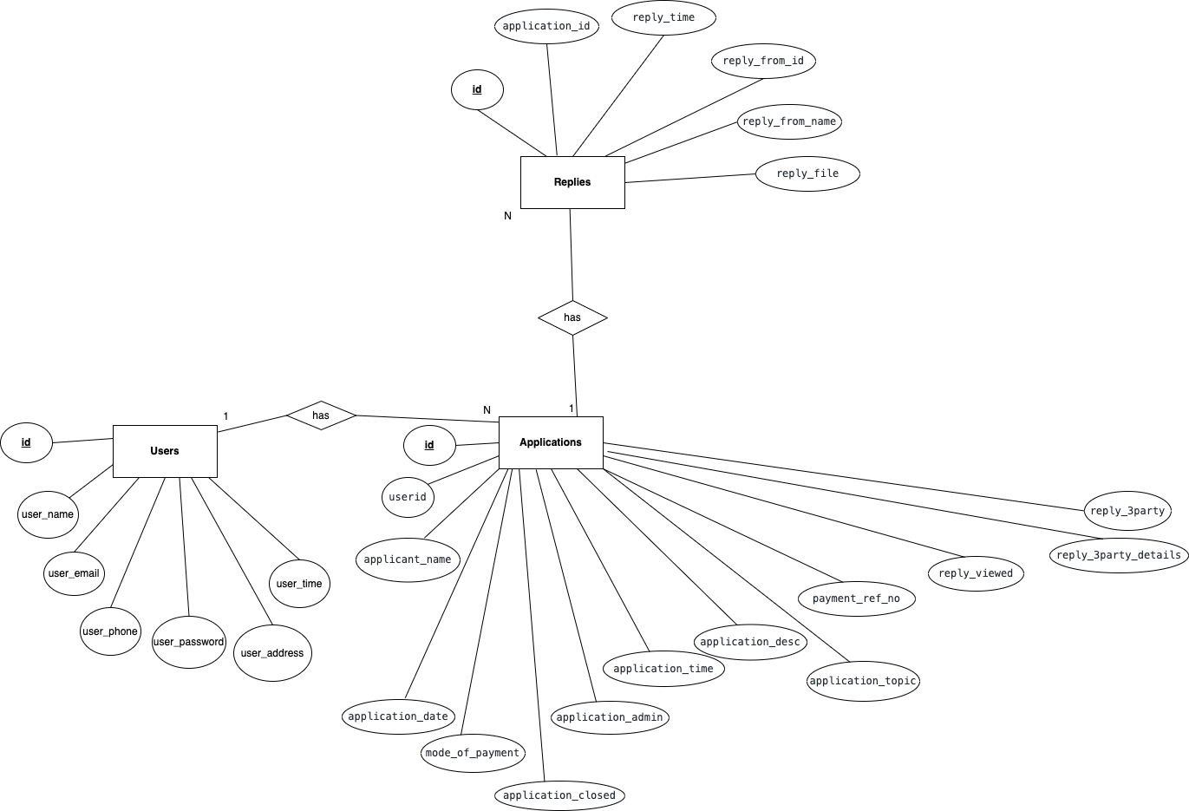
ER Diagram of the proposed system
E-R Diagram

Slide 8
DFD (Data flow diagram)
A data flow diagram shows the way information flows through a process or system. It includes data inputs and outputs, data stores, and the various sub processes the data moves through. DFDs are built using standardized symbols and notation to describe various entities and their relationships. Data flow diagrams visually represent systems and processes that would be hard to describe in a chunk of text.

Slide 9
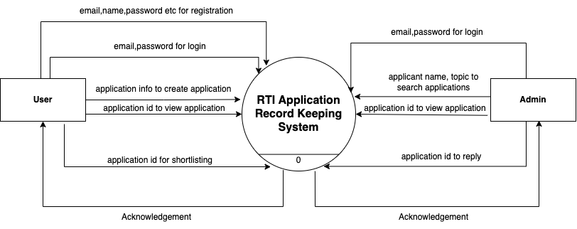
ZERO LEVEL DFD of proposed system
Zero Level DFD

Slide 10
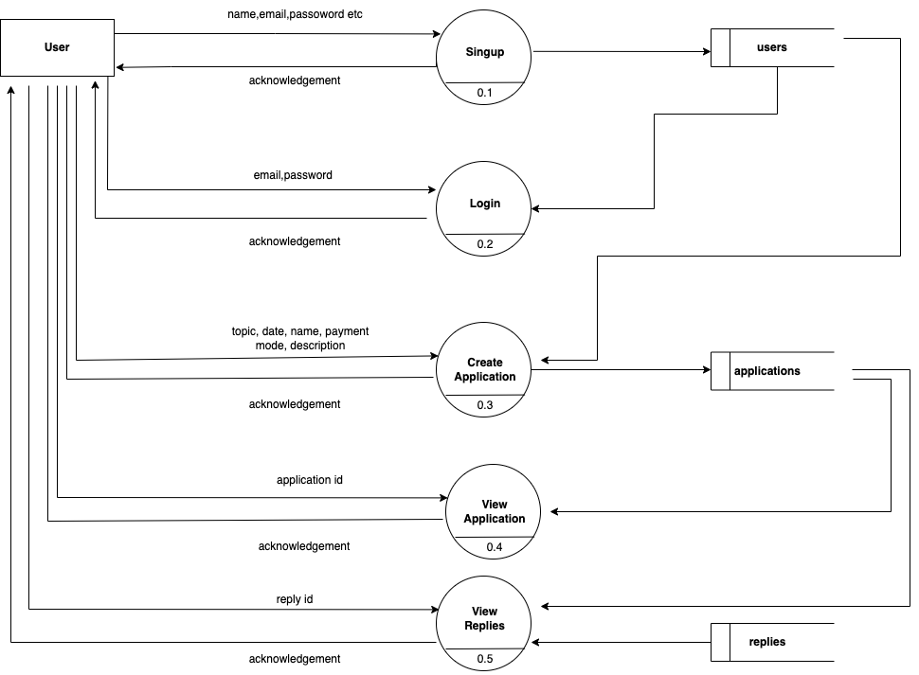
User DFD of the proposed system
User DFD Diagram

Slide 11
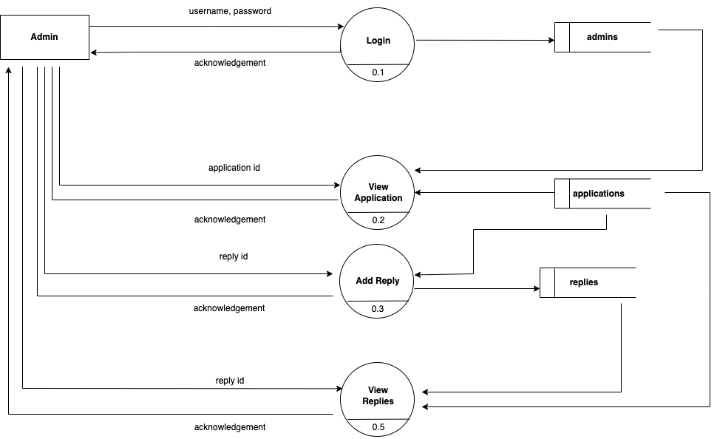
Admin DFD of the proposed system
Admin DFD DIagram

Slide 12
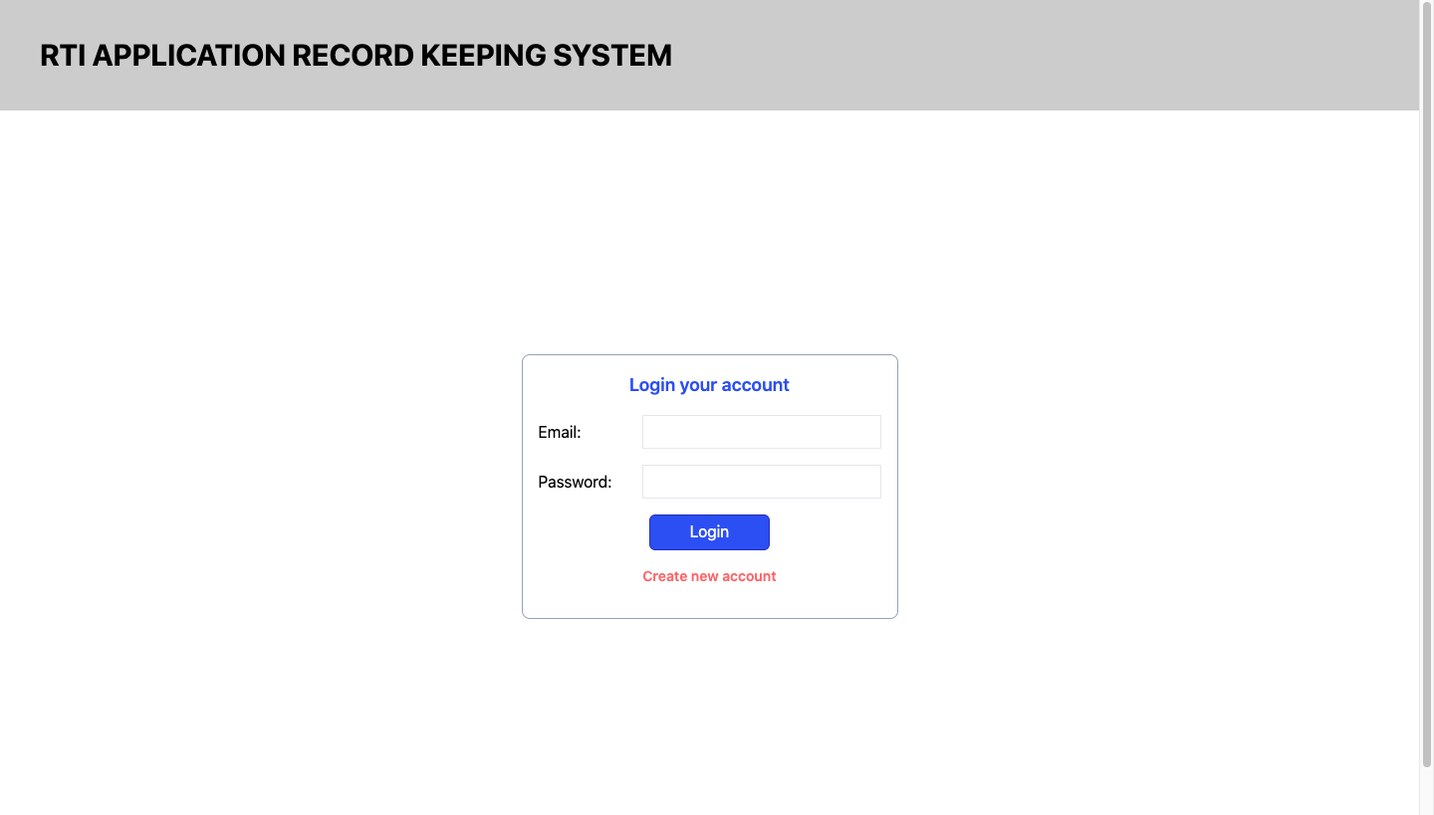
Some Snapshots of the System (User Login)

Slide 13
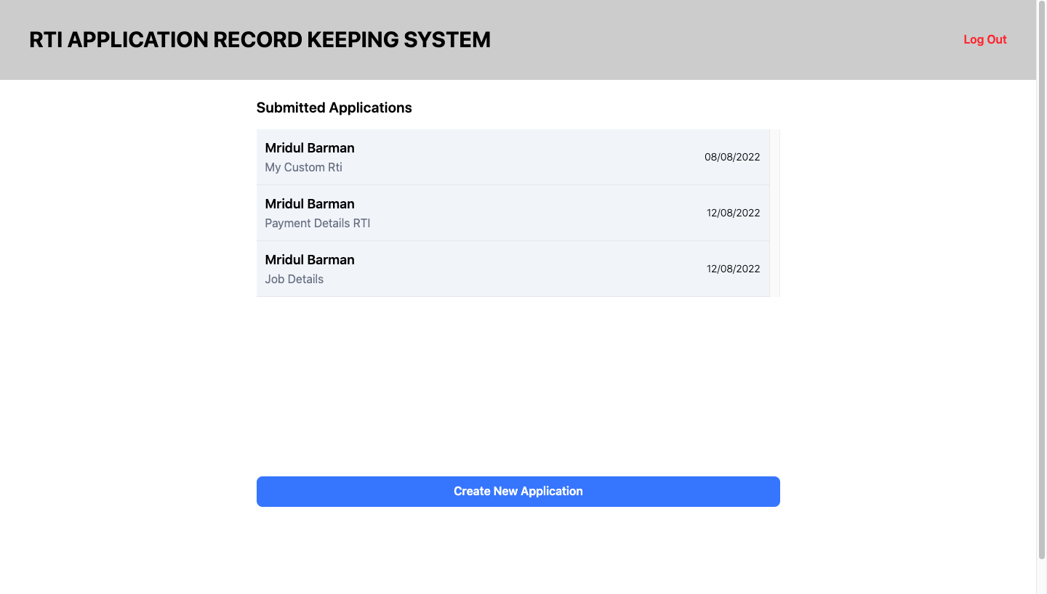
Some Snapshots of the System (User Home)

Slide 14
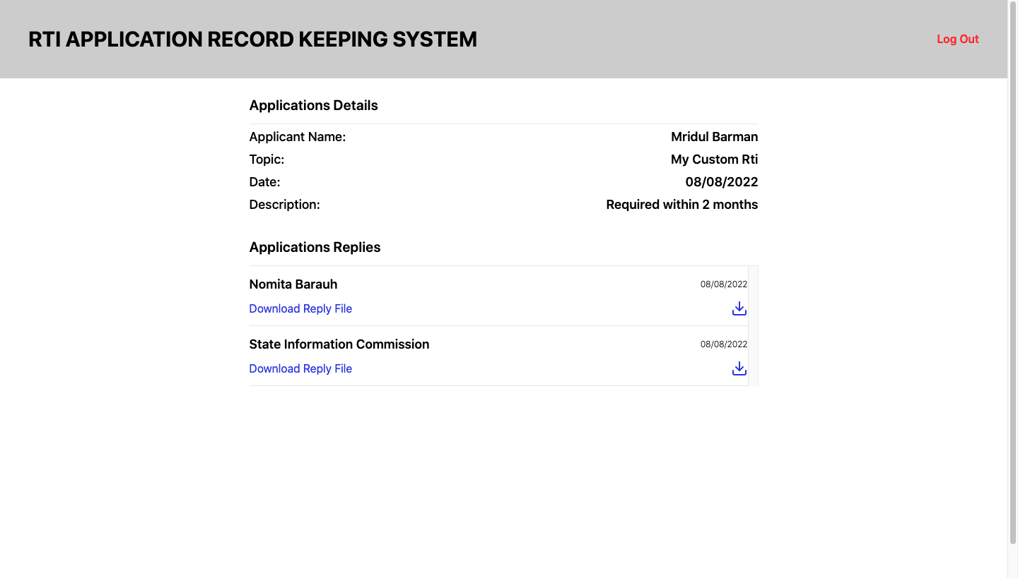
Some Snapshots of the System (User Replies)

Slide 15
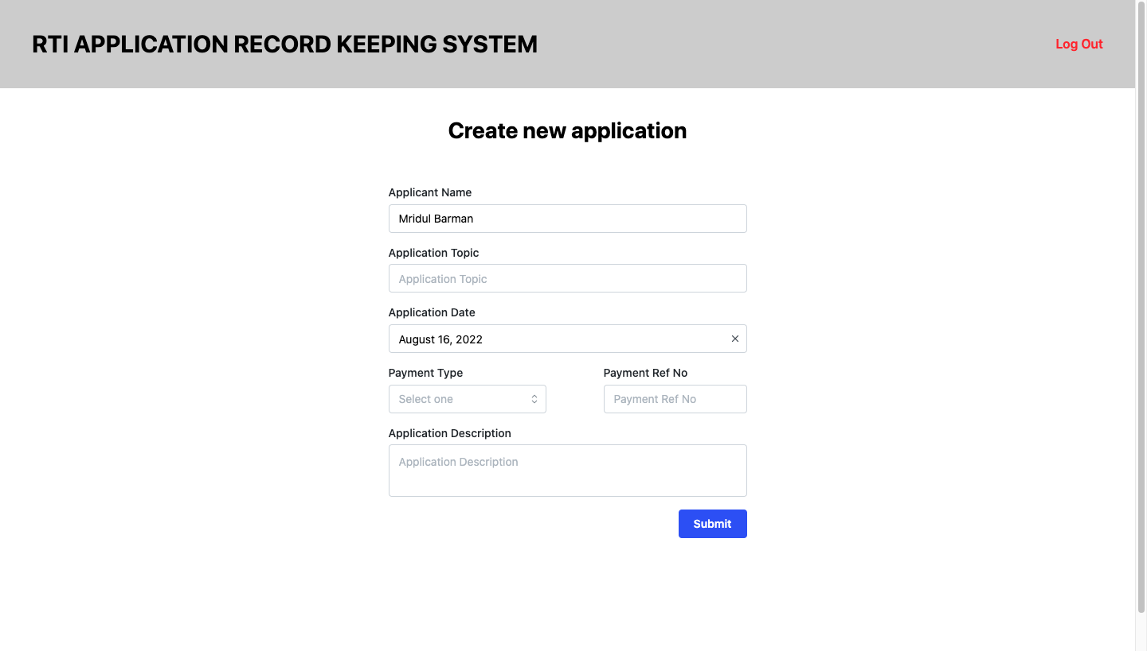
Some Snapshots of the System (New Application Apply)

Slide 16
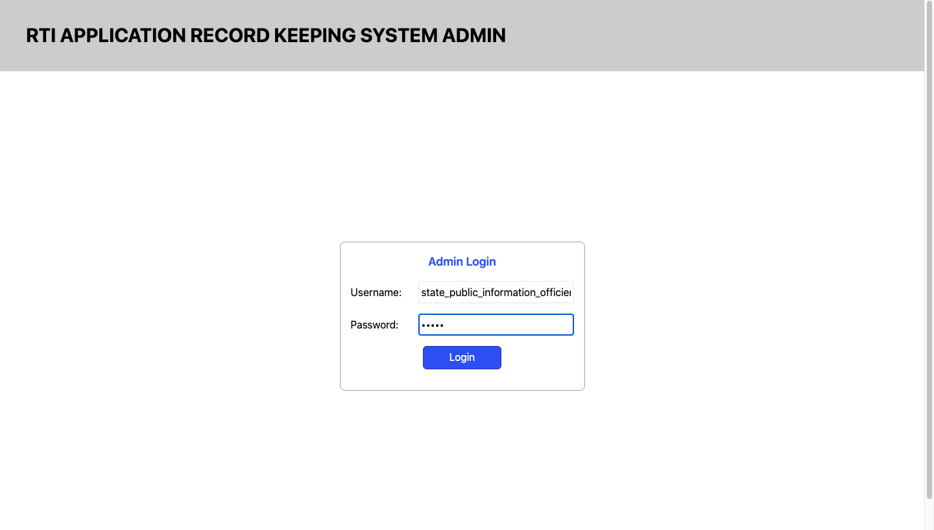
Some Snapshots of the System (Admin Login)

Slide 17
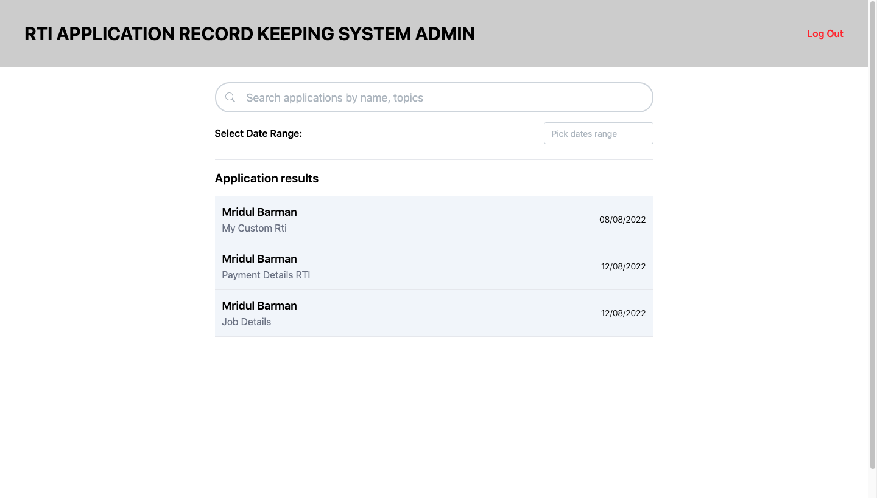
Some Snapshots of the System (Admin Home)

Slide 18
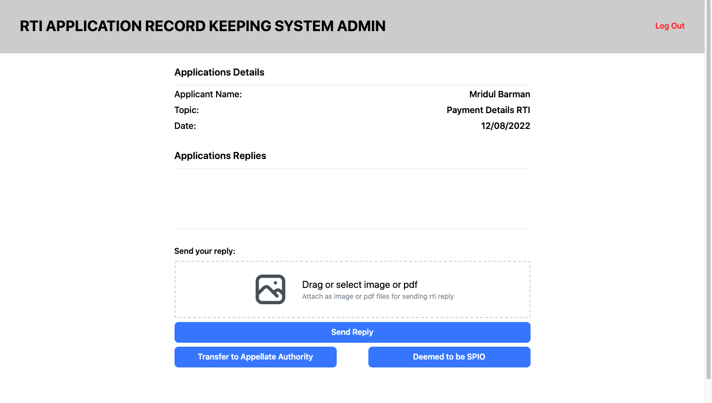
Some Snapshots of the System (Admin Send Reply)

Slide 19
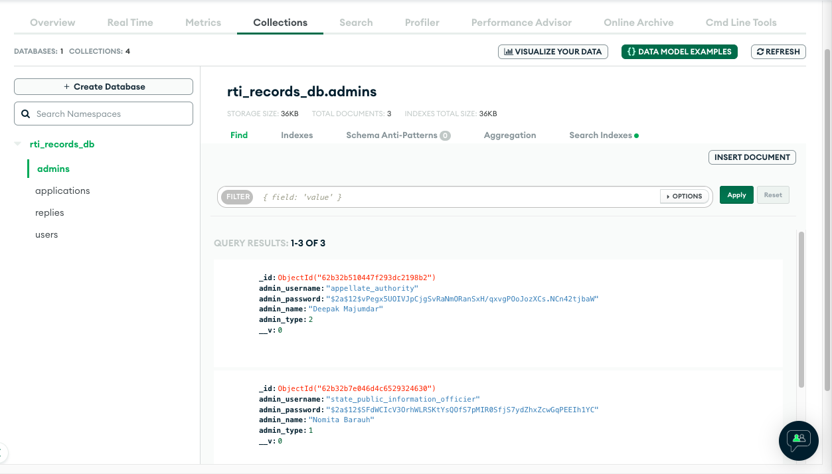
Some Snapshots of the System (Database)

Slide 20
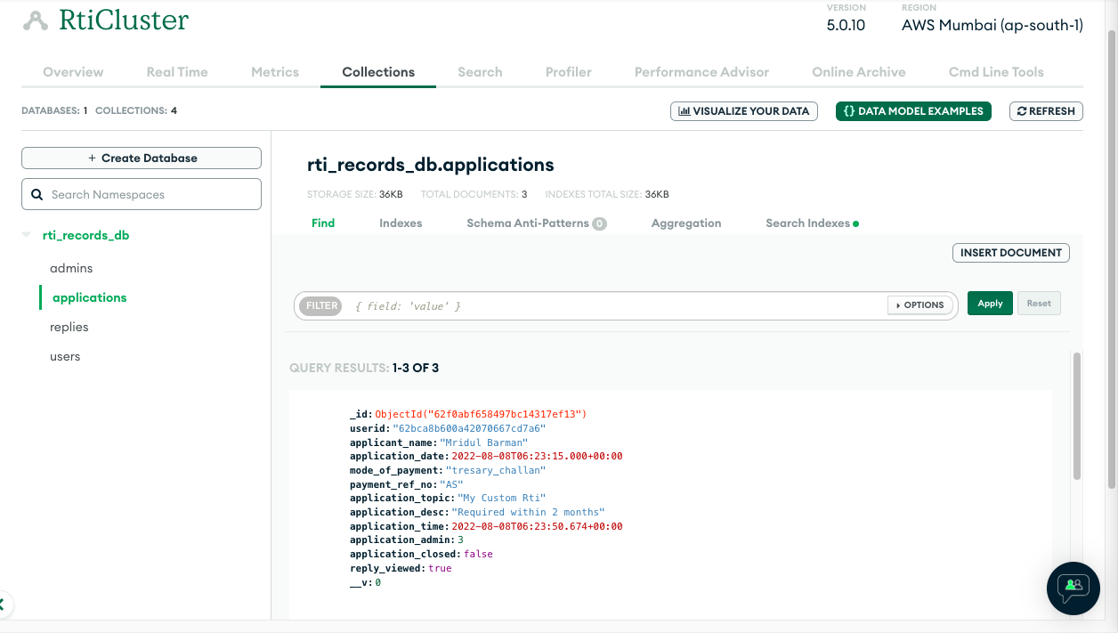
Some Snapshots of the System (Database)

Slide 21
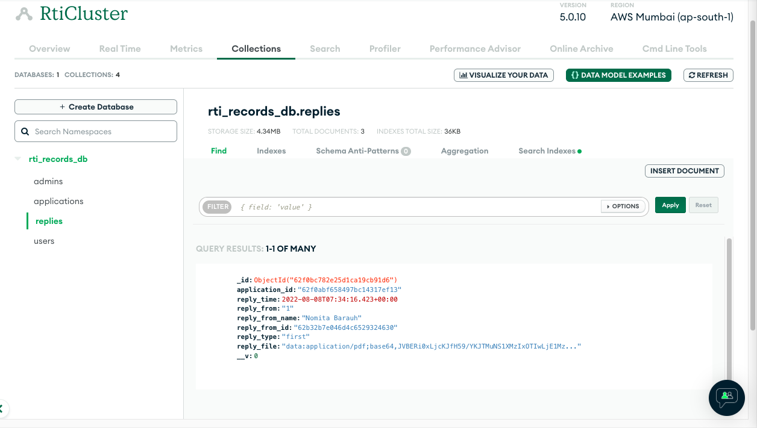
Some Snapshots of the System (Database)

Slide 22
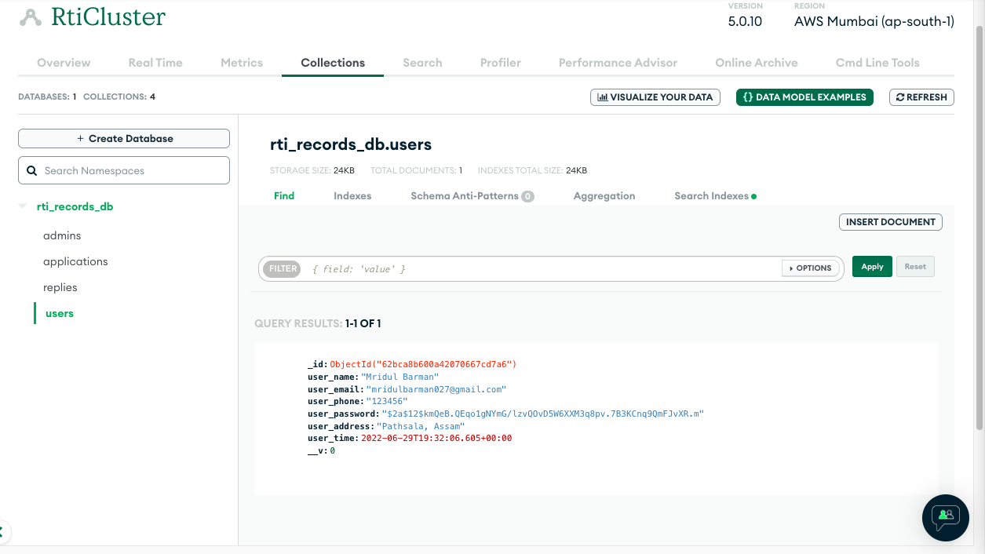
Some Snapshots of the System (Database)

Slide 23
Result & Discussion
The major goal of this project is to allow anyone to file RTI from anywhere and making managing rti applications simple and fast. In this web application user first signup with their details and then login with email and password. After logging-in user can create new rti application with topic, payment details and description.
Admin will view the application and give replies to users or transfer the application to other appellate authorities or to third parties.
Full project is using mongodb as its main database and nodejs as server with react as ui framework. Its using graphql for managing its apis.

Slide 24
Conclusions
The main motive of the “Rti Application Record Keeping System” is to computerize the way of keeping all the records of rti applications and developing an easier way to apply for rti and also develop an easy user interface. The system satisfies the needs of the users and is expected to eliminate the problems of the manual system.

Slide 25
Future work
Can be implemented in every government department and can add more security and validations like random password generation, adding more modules to the system, hosting it online to make it more accessible to a wide range of users
It can also support multi regional language support in website so that anyone can use this who doesn’t have proper knowledge in english.

Slide 26
LIST OF REFERENCES
https://www.wikipedia.org
https://www.geeksforgeeks.org
https://www.mongodb.com
https://www.typescriptlang.org
https://graphql.org
https://tailwindcss.com
https://nodejs.org/en
https://rtionline.gov.in

Slide 27
Thank you!

